Slide 1
DISCO

Slide 2
Demo Scenario
You are part of the US navy. Your job is to monitory a designated part of US waters. You will have a task of searching for an object in your territory.

Slide 3
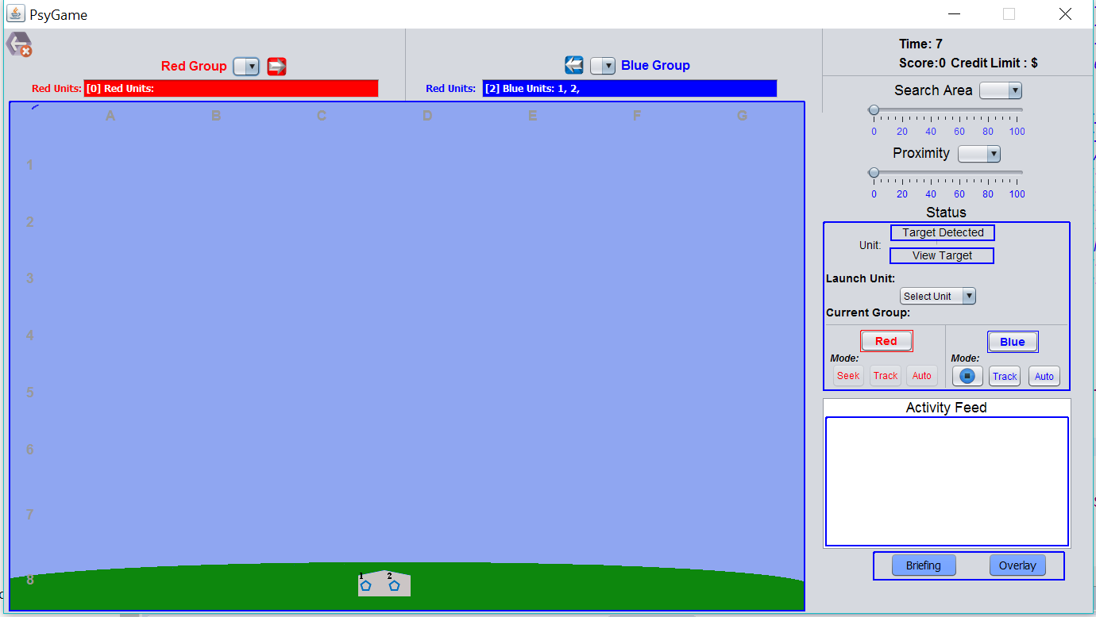
Demo Scenario
You will open up the game to a screen that looks like this
Terminology:
- The blue pentagons at the bottom of the screen are called units
- The item you are searching for is called a target

Slide 4
Demo Scenario
In order to know where you are searching select the “Briefing” button in the bottom right-hand corner

Slide 5
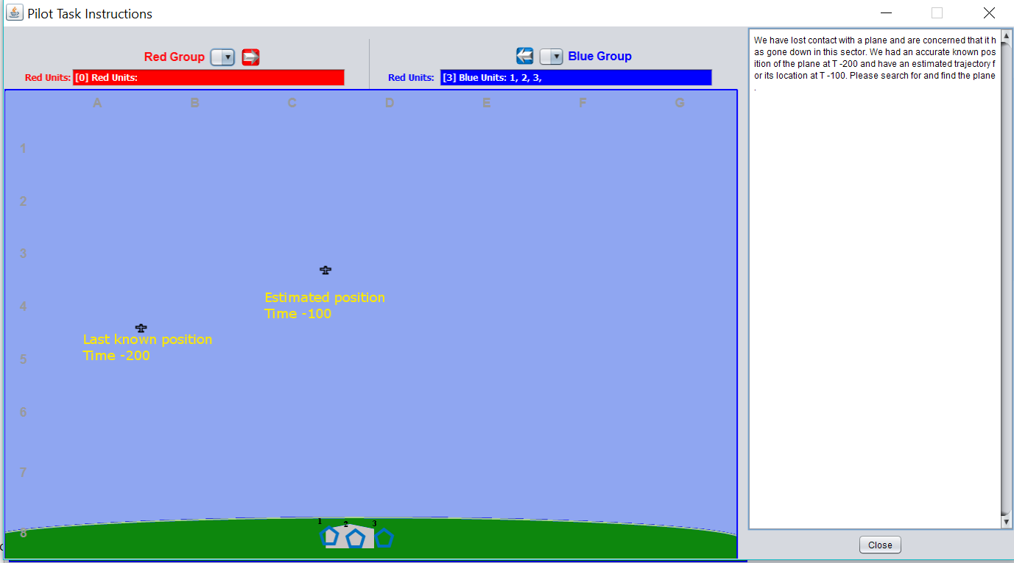
Demo Scenario
Once you have selected the briefing a screen like this will pop up. The text on the right tells you what target you are searching for and why. The images of the Time-200 and Time -100 will explain where the lost object was last seen and where it is predicted to be

Slide 6
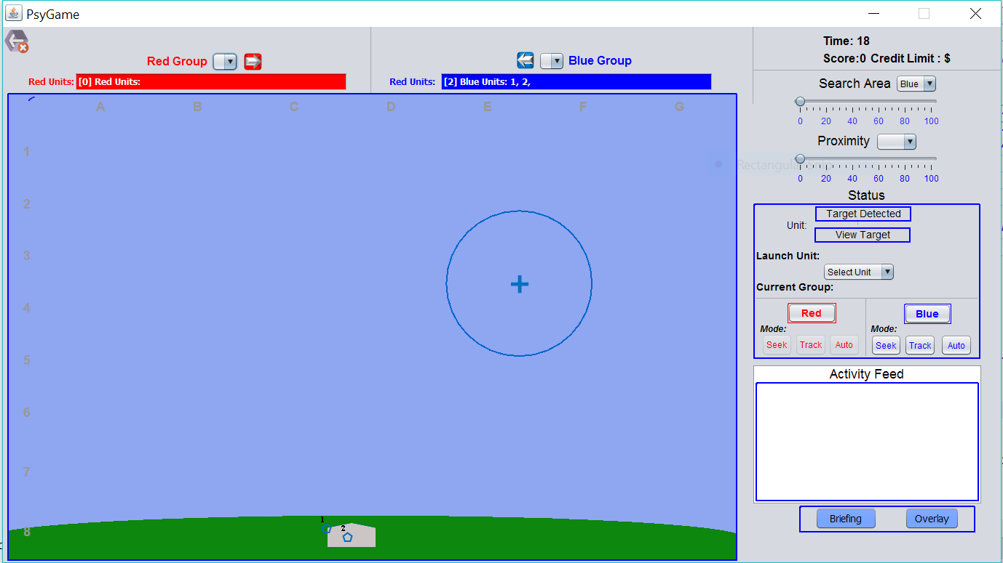
Demo Scenario
In order to direct the units to search for the object you must right click on the blue area, and select blue units. You are then able to click on the screen where you want the units to search

Slide 7
Demo Scenario
You are able to change the size of the search area by moving the indicator along the scale from 0 to 100. You are also able to change the proximity (how close the units fly to each other) by selecting blue from the drop down menu and moving the indicator along the scale.

Slide 8
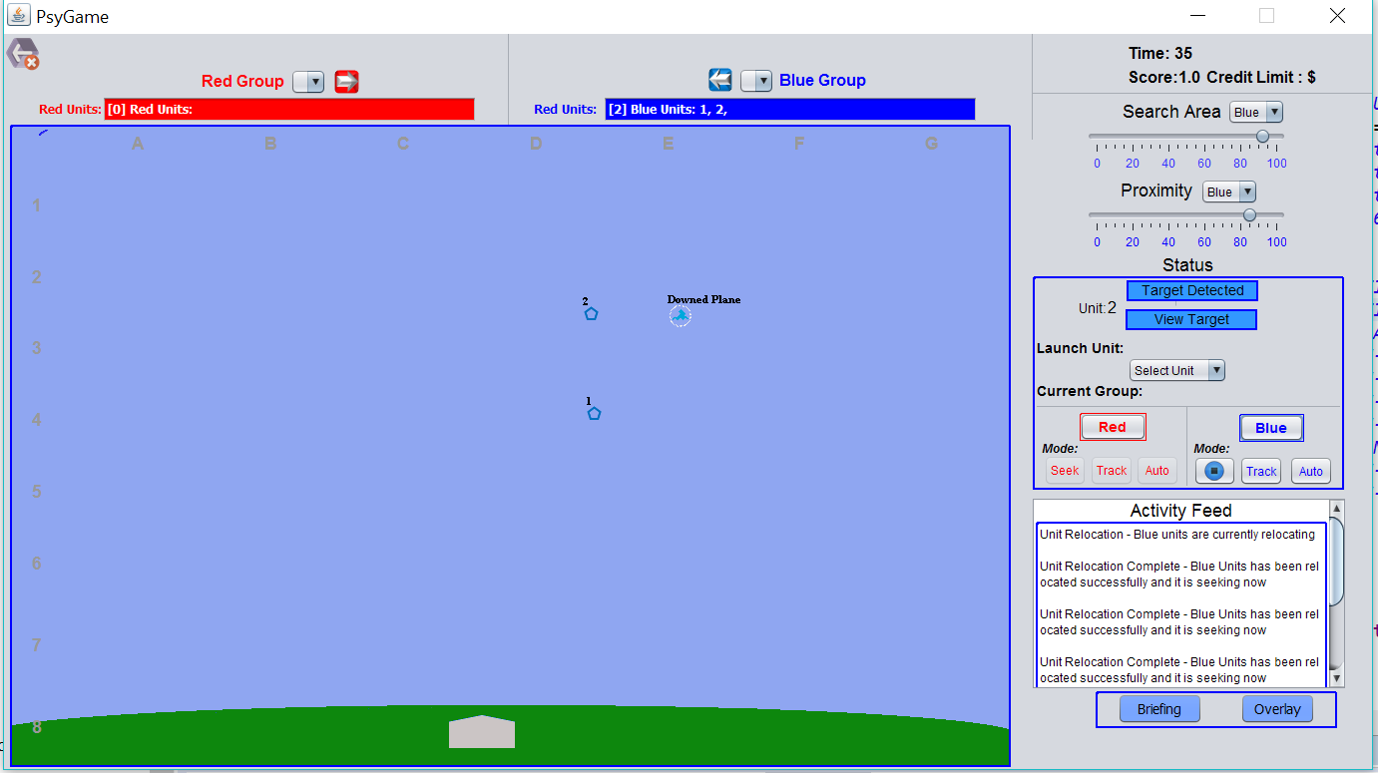
Demo Scenario
Once you have found a target the target detected button and view target button will turn blue

Slide 9
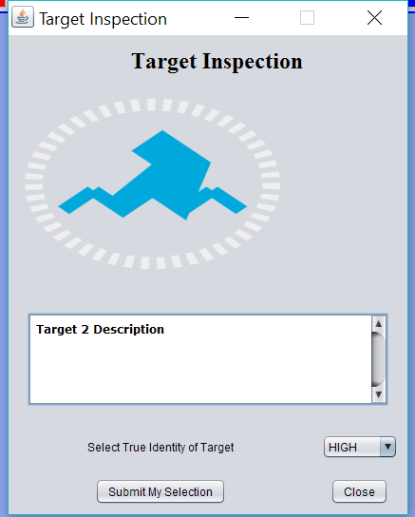
Demo Scenario
Press on the view target button to read a description of the object that you found. If the description matches the object mentioned in the briefing, then the identity of the target is “High”. If the description does not match the object mentioned in the briefing, then the identity of the target is “Low”

Slide 10
Demo Scenario
There is a time limit of 300 seconds for the game
You will also notice that there is a score. In order to receive points you must detect a target and then correctly label the priority as “high” or “low”

Slide 11
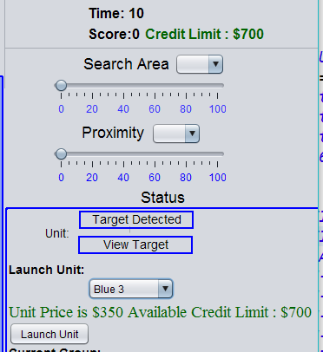
Demo Scenario
In some scenarios you will be able to purchase more units, to have greater ability to search for the target.
To launch more units, drop down the select unit menu on the right-hand side, and select a unit to launch. Some of the units will cost more than others. The units that cost more have better accuracy

Slide 12
Demo
In this scenario you are working for the US Navy. You have been informed that you have lost contact with a plane and are concerned that it may have gone down in your sector. You are given the last known accurate position of the plane and the estimated trajectory. Your job is to send the units out to find the downed plane.
There may be other objects in the area that you will find that are not the downed plane.
In this scenario you are given two units and do not have any funds to launch any more units

Slide 13
Demo2
In this scenario you have been told that an enemy battleship is in the area. You have currently lost sight of the ship, but know it’s last known location and have an estimated trajectory for its location. Your job is to send out units and find the enemy battleship.
There may be other targets that are not the enemy battleship.
In this scenario you are given $700 to spend on launching more units. Each unit costs a different amount based on its detection radius. The larger the cost the better the unit.
The advantage of sending out more units is a greater chance for detection of your target.

Slide 14
Demo3
In this situation you are apart of NASA. You have been told that you have lost contact with the Mars Rover and need to find it to repair any damages. You are given the last known location of the rover and an estimated trajectory position.
There may be other objects that are not the Mars Rover.
In this scenario you have been given a $20 credit limit. Each unit costs a different amount based on its detection radius. The larger the cost the better the unit.

Slide 15
Demo4
In this scenario multiple enemy battleships have been spotted in this sector. You have the last known location of one of the ships and an estimated trajectory position. You may come across the other battleships as you are searching as well as several local boats.
The battleships will be moving fast so the briefing may not stay accurate or useful for very long.
The timer will be counting down in this scenario to increase pressure as you only have 300 seconds to find and neutralize the battleships.
In this case you do not have any funds to send out more units

Slide 16
Demo5
In this scenario you are working for the US Navy. You have been informed that you have lost contact with a plane and are concerned that it may have gone down in your sector. You are given the last known accurate position of the plane and the estimated trajectory. Your job is to send the units out to find the downed plane.
There may be other objects in the area that you will find that are not the downed plane.
In this scenario you are given two units and do not have any funds to launch any more units
This briefing may or may not be accurate for your search
The timer will be counting down to increase pressure to save the passengers in the plane

Slide 17
Demo6
In this scenario you have been told that the Navy has lost contact with one of its data sensors due to a recent storm. You are to find the sensor and recover information about the storm. You have the last known location of the data sensor as well as an estimated trajectory.
You may come across a large number of other targets that are not the data sensor. Some of these targets will be moving and others will not.
In this scenario you will have a $30 credit limit. Some of the units you will be able to afford and some you will not.

